Slide 1
Computer Network Laboratory (using Cisco Packet Tracer) Experiment-2

Slide 2
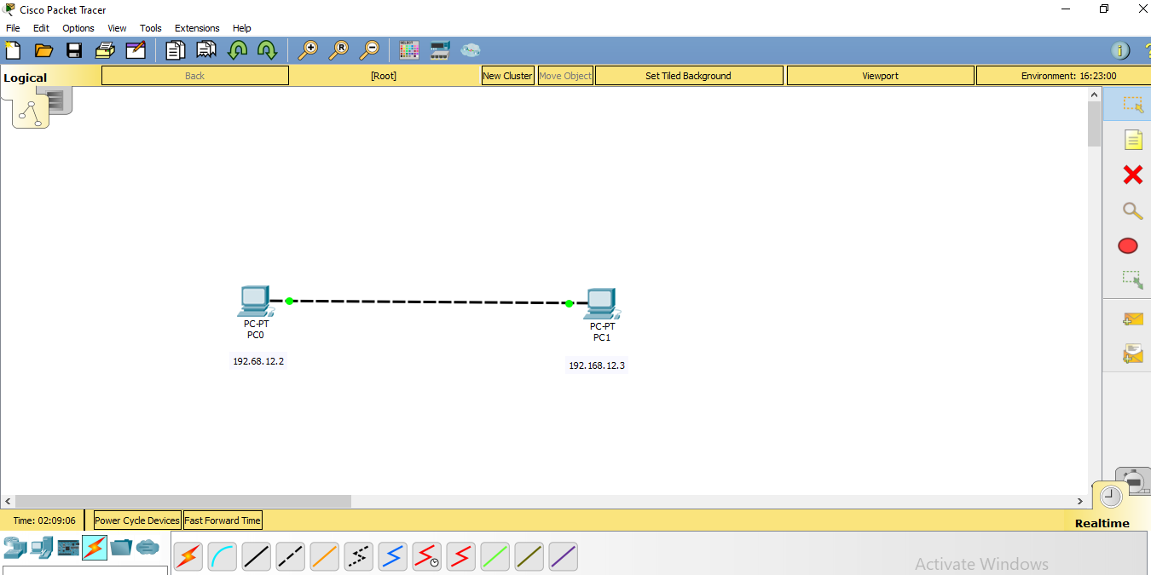
How to level the IP address

Slide 3
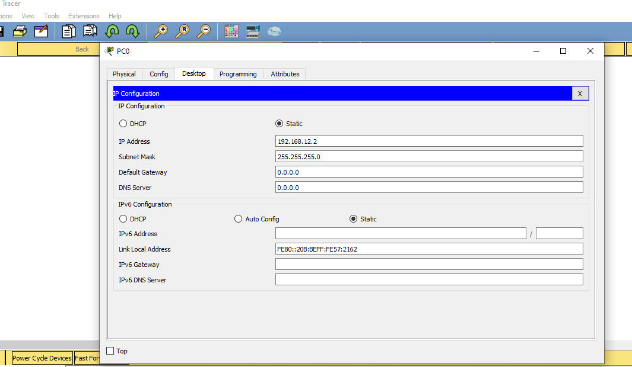
Steps
Allocate IP addresses to the PCs

Slide 4
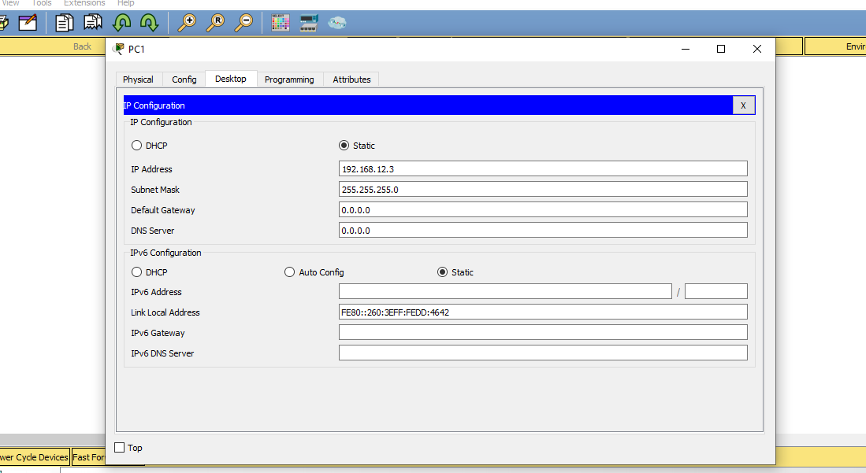

Slide 5
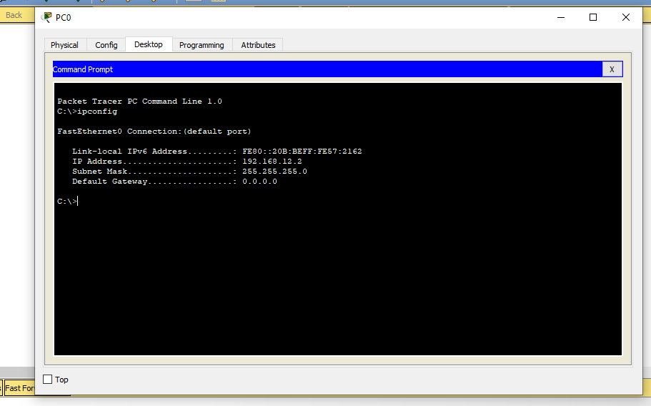
To check the ip address of PC0

Slide 6
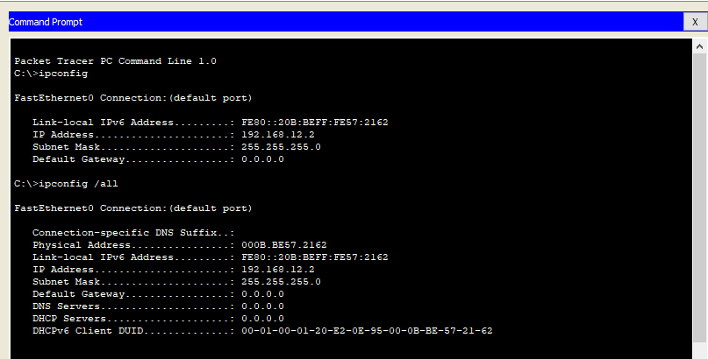
To check the MAC address

Slide 7
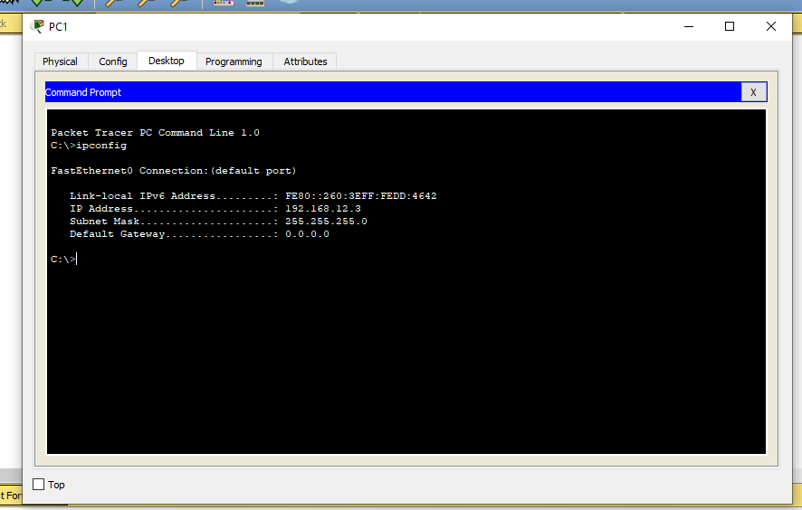
To check the ip address of PC1

Slide 8
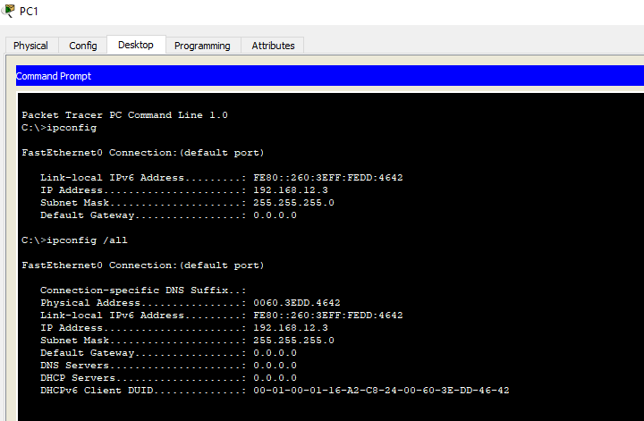
To check the MAC address of PC1

Slide 9
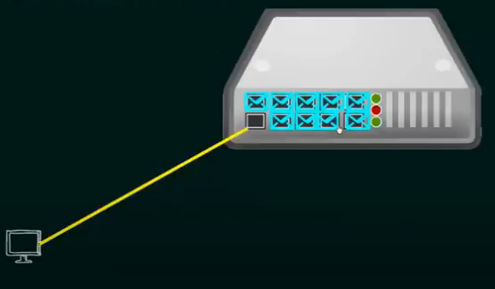
How to connect with HUB?
So, what ever the data that is sent
By the computer through the 1st port
is copied and sent through all other
Ports, which are connected with other
computers

Slide 10
Connection of Hub to form LAN
Connect End Devices to the ports of HUB
Use copper straight through cable to connect
Give ip addresses to all the individual pc, level the ip address for each pc
Check using ping command
Go to simulation mode send the packet

Slide 11
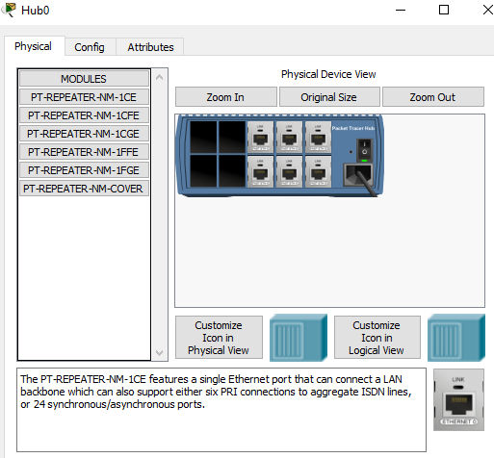
Inside the HUB

Slide 12
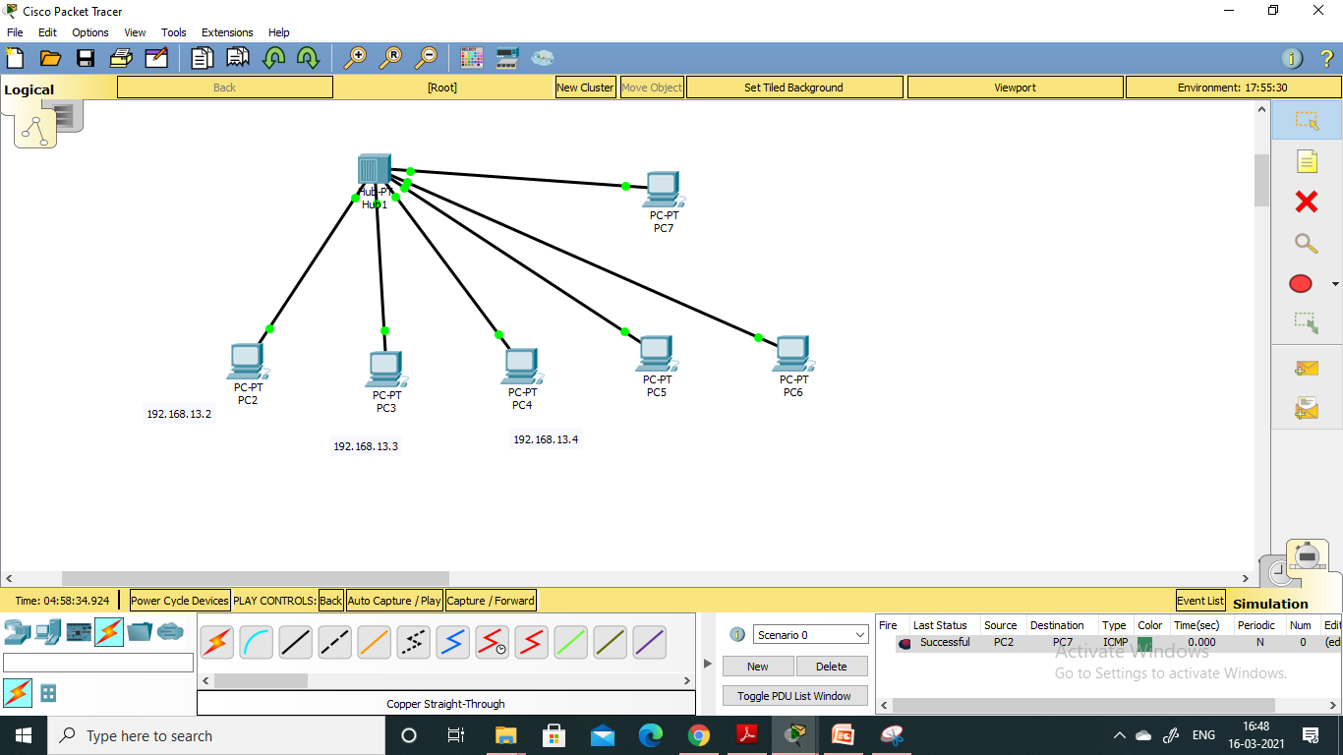

Slide 13
Connection of switch to form LAN
Connect End Devices to the ports of Switch
Use copper straight through cable to connect
Give ip addresses to all the individual pc, level the ip address for each pc
Check using ping command
Go to simulation send the packet

Slide 14
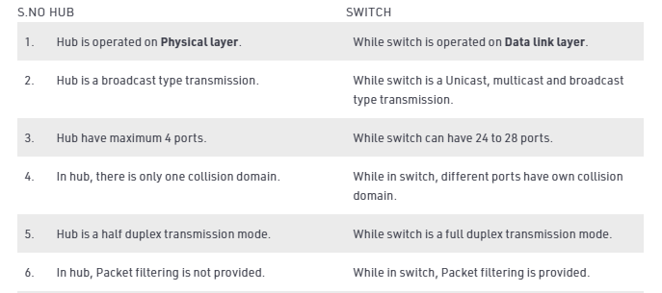

Slide 15
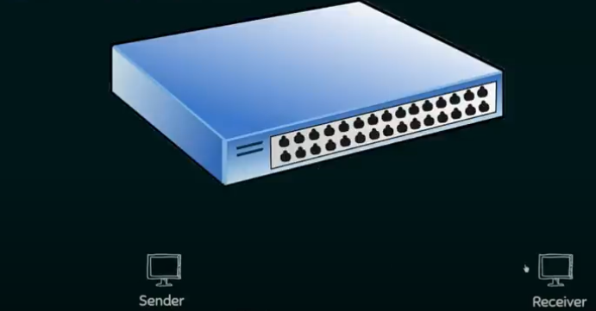
Connection of switch

Slide 16
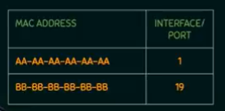
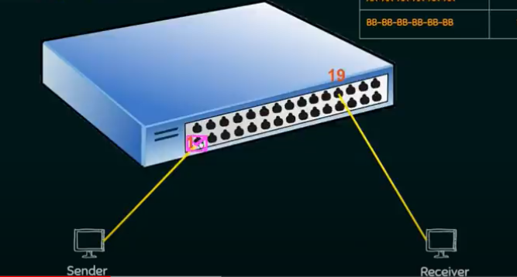

Slide 17
Creation of LAN using switch
Create single local area network
Required components
3 end devices
1 switch (2960)

Slide 18
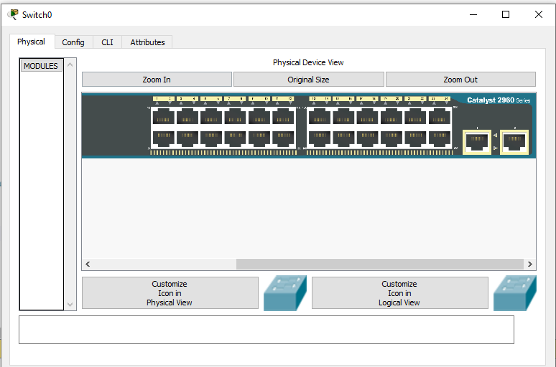
Physical view of switch
24 Fast Ethernet port and2 Gigabit Ethernet port

Slide 19
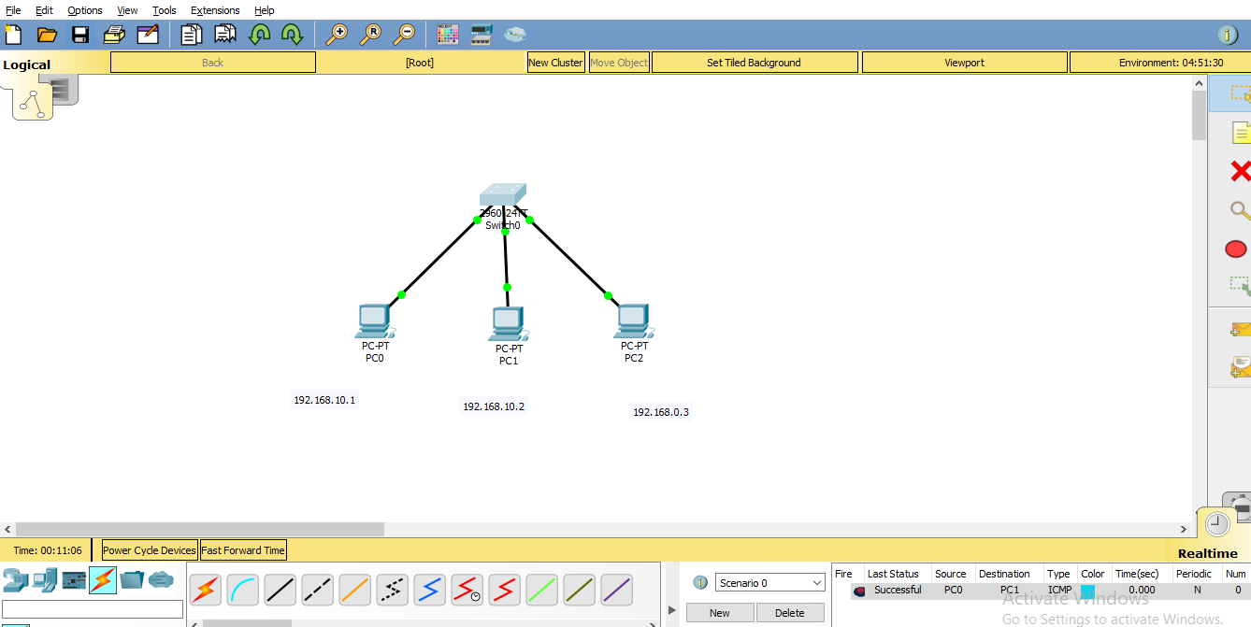

Slide 20
MAC Address Tables
A MAC address table, sometimes called a Content Addressable Memory (CAM) table, is used on Ethernet switches to determine where to forward traffic on a LAN.
Now let's break this down a little bit to understand how the MAC address table is built and used by an Ethernet switch to help traffic move along the path to its destination

Slide 21
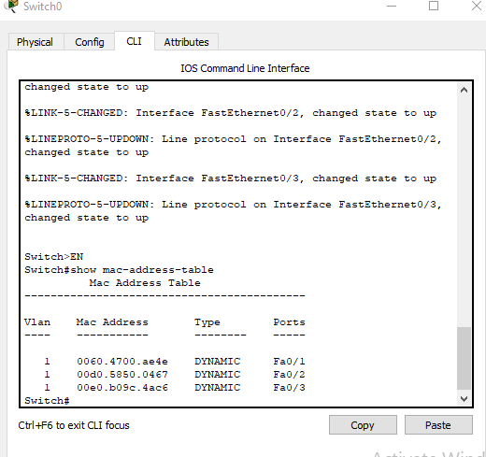

Slide 22
Creation of Multiple LAN
Create two local area network and connect via router
Required components
6 end devices
2 switches (2960)
1 router (2911)

Slide 23
Steps
Place all the devices in the workspace
Assign IP addresses to all the PCs of LAN1
10.0.0.2,10.0.0.3,10.0.0.4
Assign IP addresses to all the PCs of LAN2
192.168.0.2,192.168.0.3,192.168.0.4

Slide 24
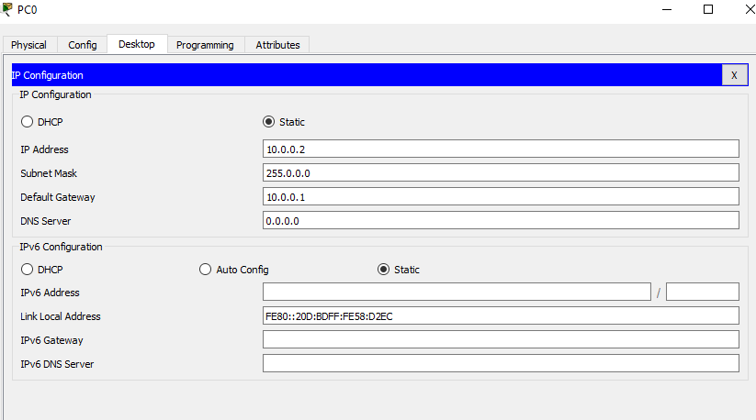
Set the default gateway for each end device

Slide 25
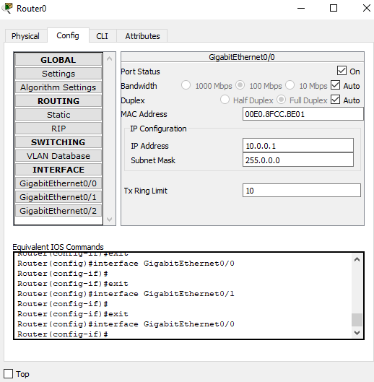

Slide 26
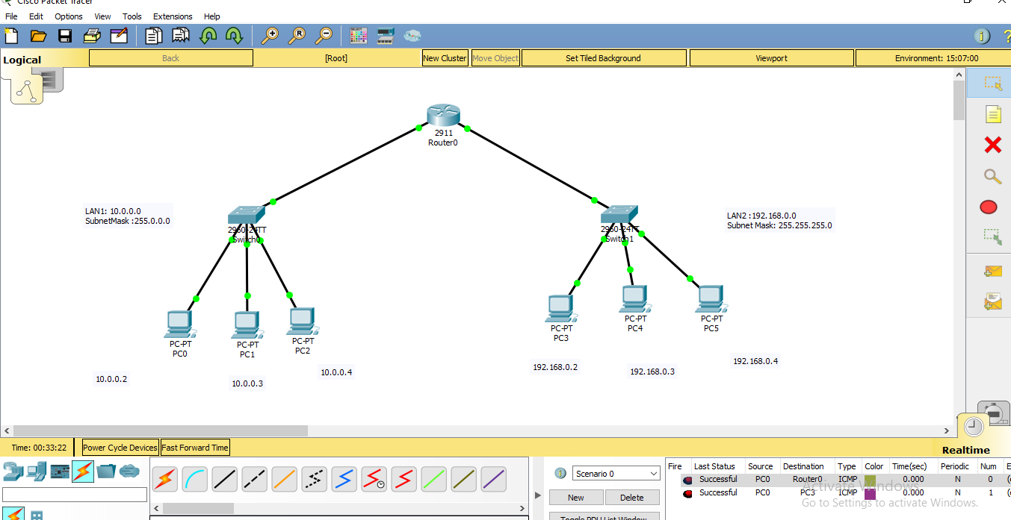

Slide 27
Computer Network Laboratory (using Cisco Packet Tracer) Experiment-5

Slide 28
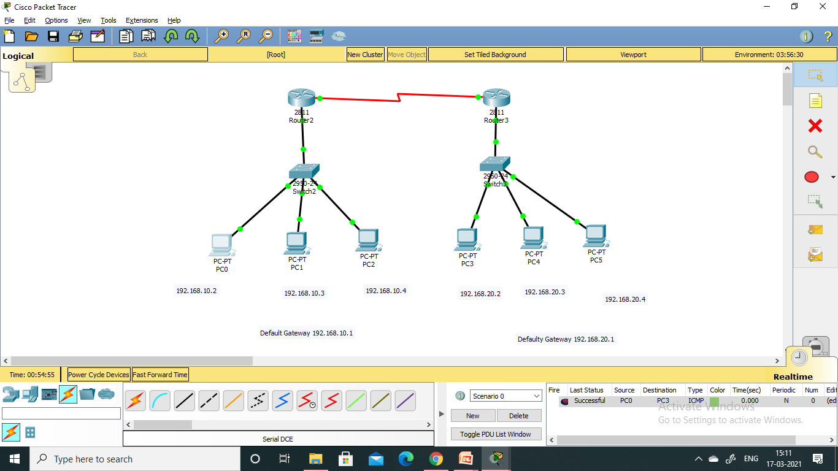
Creation of WAN

Slide 29
Creation of Network
Create single network
Required components
6 end devices
2 switch (2950-24T)
2 Router (2811)

Slide 30
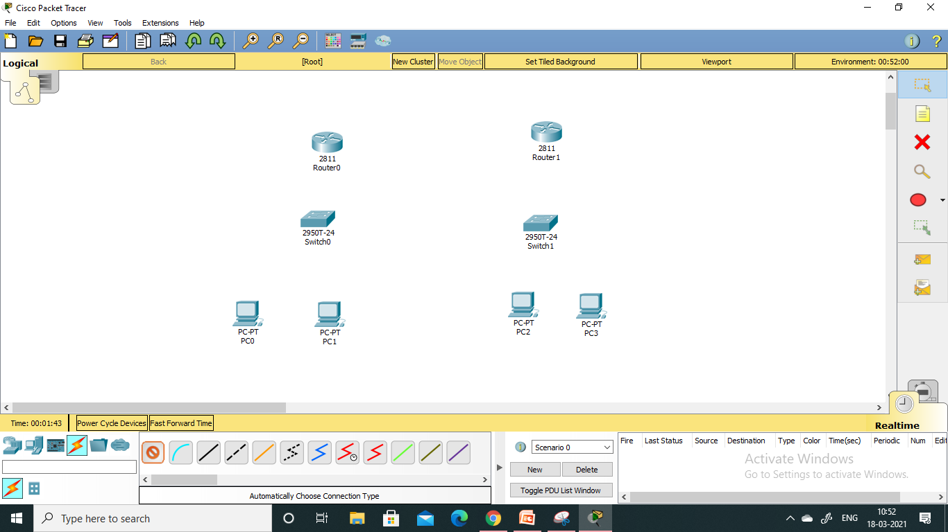
Place the devices

Slide 31
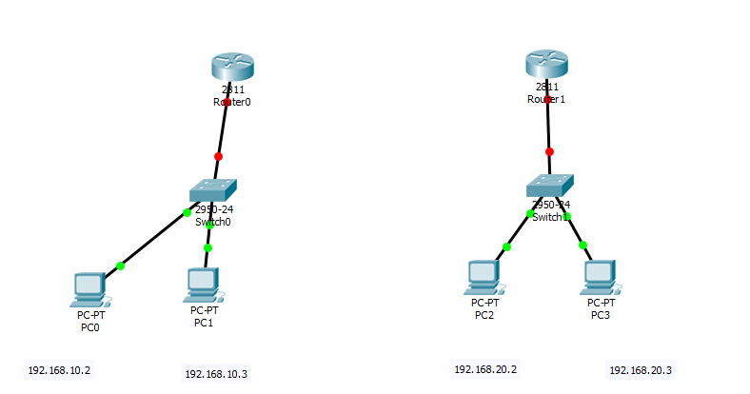
Assign IP to all the pc and level it
Give the gateway address all for both the LANs

Slide 32
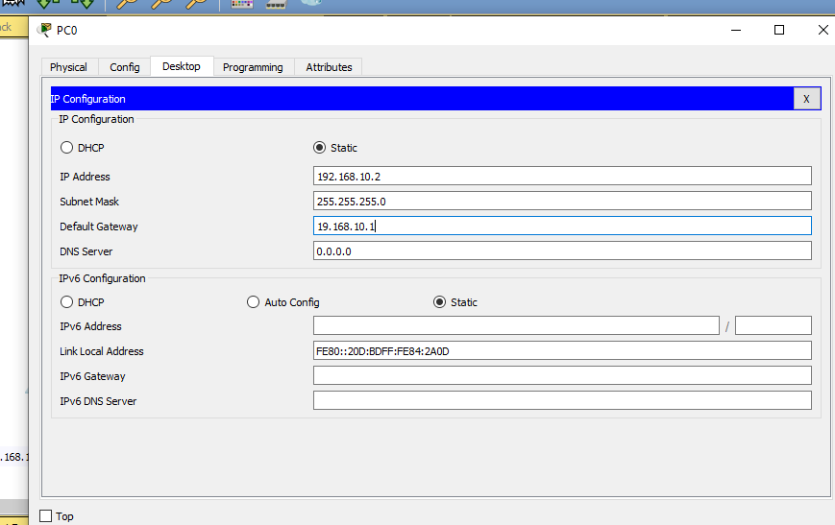

Slide 33
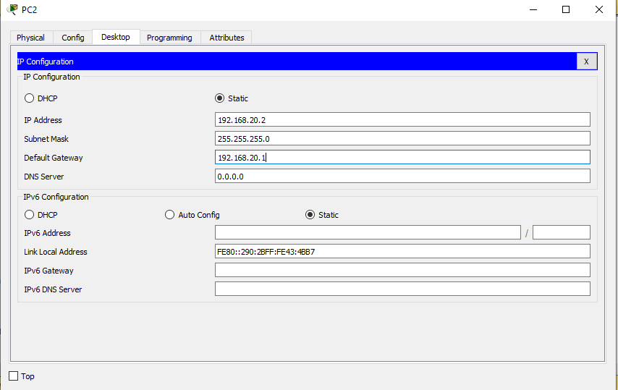

Slide 34
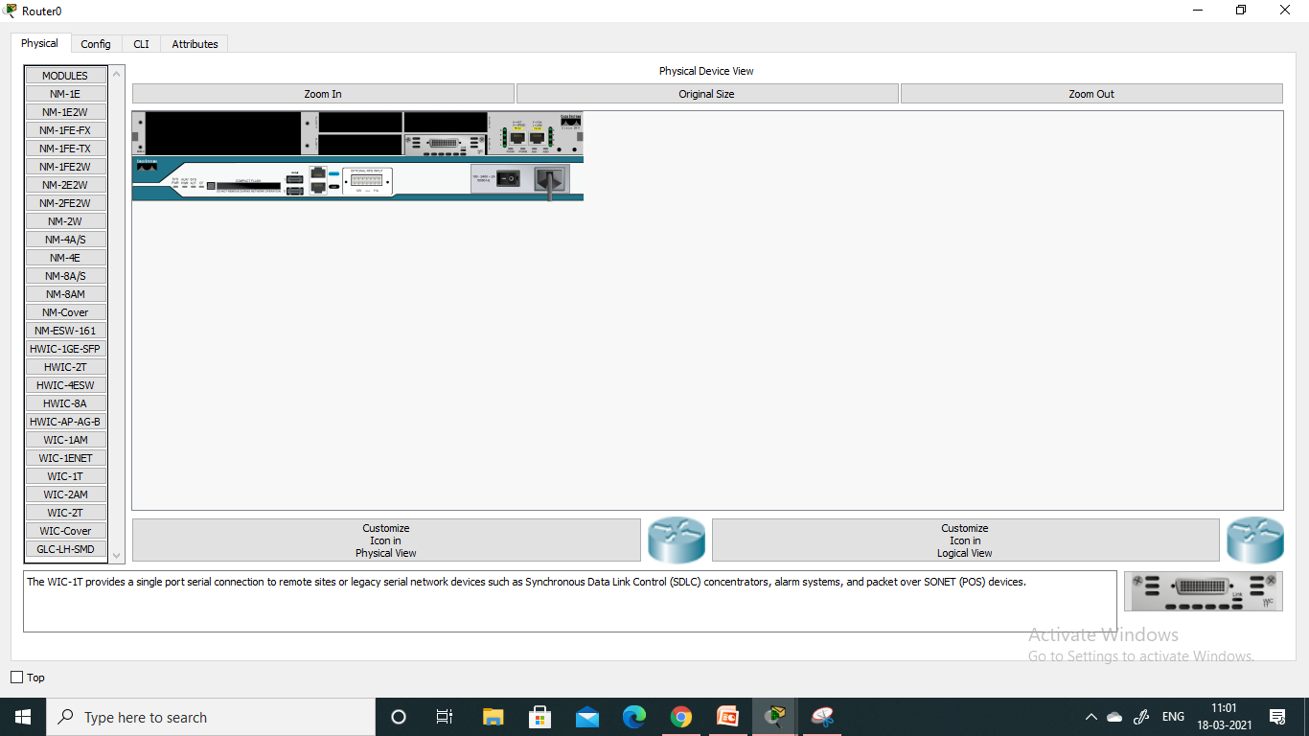
steps
Go the 1st router: in physical tab, switch off
Drag and drop WIC-1T and switch on the power
Similarly do it for the second router

Slide 35
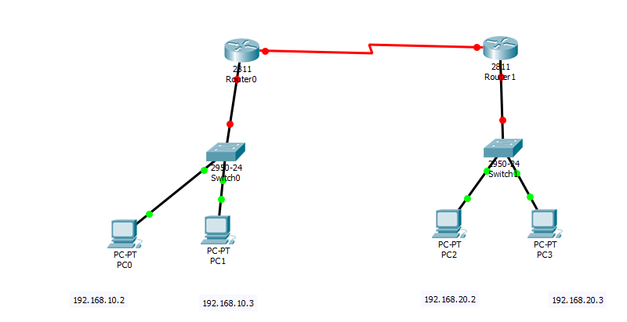
steps
Use Serial DCE for connection between two routers
Drag and drop WIC-1T and switch on the power
Similarly do it for the second router

Slide 36
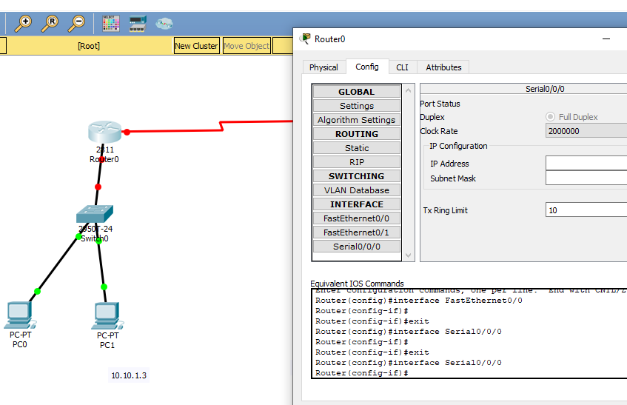
Go the router

Slide 37
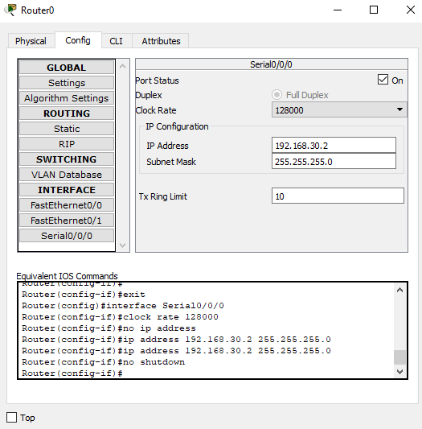
Router>config>serial 0/0/0
In router, clockrate is to b given 128000
In router, give the ip

Slide 38
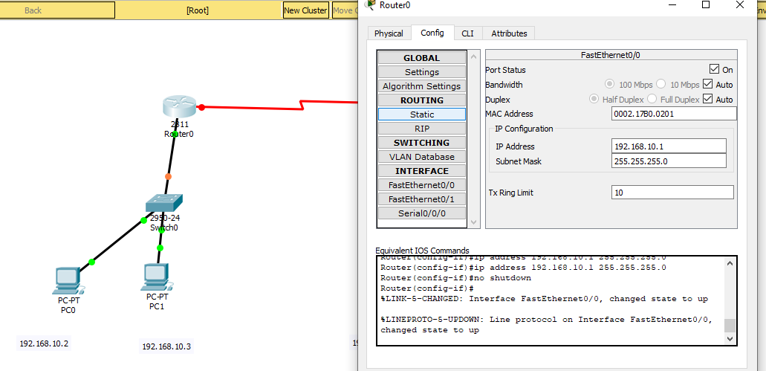
Router>config>FastEthernet 0/0
In router, give the IP which is same as default gateway 192.168.10.1
Turn it on

Slide 39
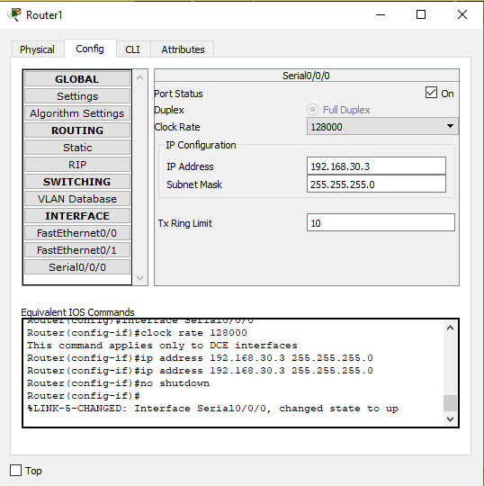
Repeat the same procedure for the second router

Slide 40
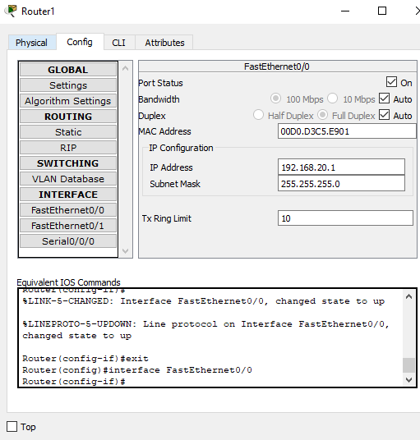
Repeat the same procedure for the second router

Slide 41
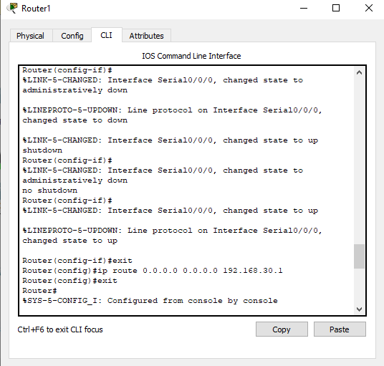

Slide 42
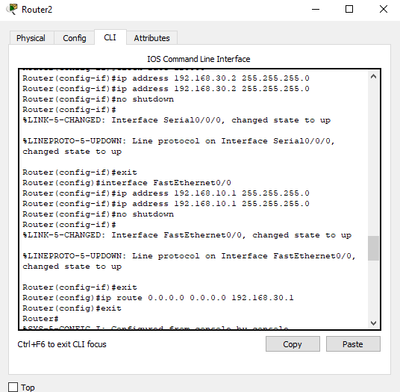

Slide 43
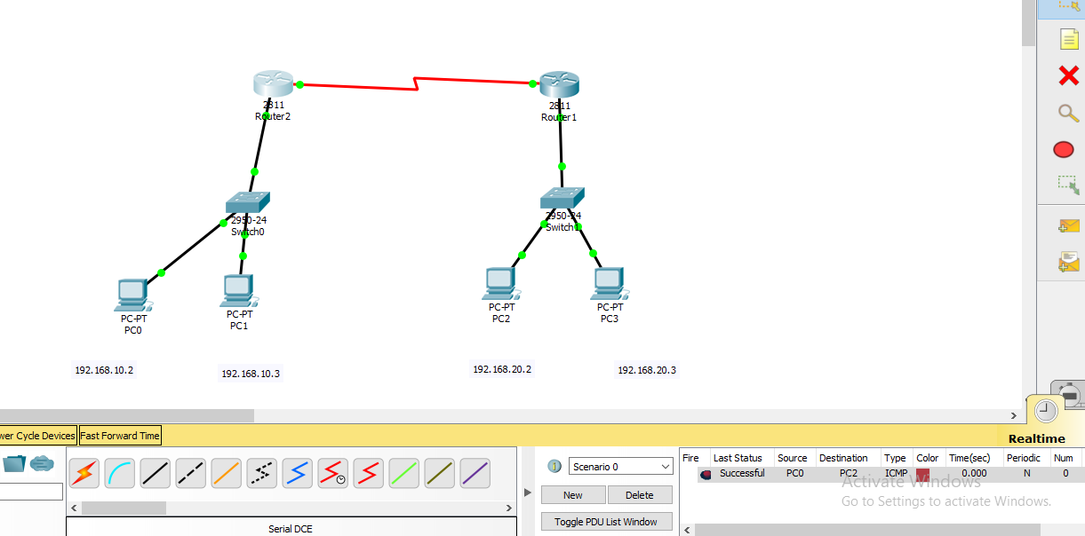
Packet transmission

Slide 44
DHCP and DNS
Dynamic Host Configuration Protocol (DHCP) is a client/server protocol that automatically provides an Internet Protocol (IP) host with its IP address and other related configuration information such as the subnet mask and default gateway
The DHCP server maintains a pool of IP addresses and leases an address to any DHCP-enabled client when it starts up on the network. Because the IP addresses are dynamic (leased) rather than static (permanently assigned), addresses no longer in use are automatically returned to the pool for reallocation.

Slide 45
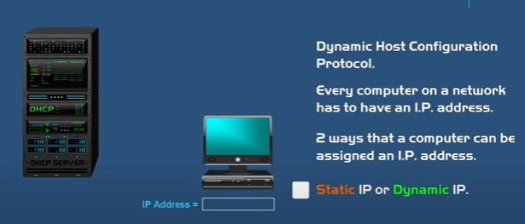
DHCP and DNS

Slide 46
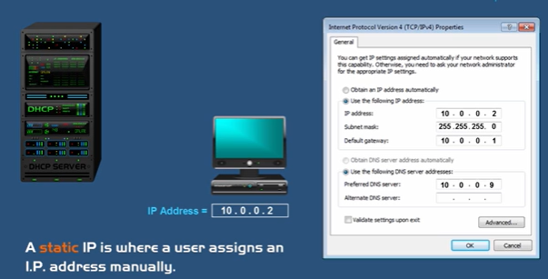
DHCP and DNS
Now a static IP is where a user assigns a computer or device with an IP address manually. Now this was the original method that was done in the beginning of networking. So as an example here we have a network connection properties window open for the network interface card on a Microsoft Windows computer

Slide 47
If you are dealing with a large network that has a lot of computers. And you also have to make sure that all the IP addresses are unique because if you assign the same IP address twice.
It would cause an IP conflict and would cause those computers to not have access to the network

Slide 48
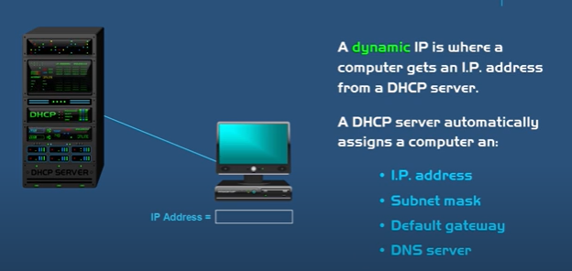
this computer is set to obtain an IP address automatically. So when you choose this option the computer would broadcast a request for an IP address on the network then the DHCP server will assign an IP address from its pool and deliver it to the computer.
And then once that's done you can verify all the different settings that the DHCP server has given your computer. And you can do this by opening up a command prompt on a Windows computer and then type in ipconfig /all and then press "enter". So as you can see here the DHCP is

Slide 49
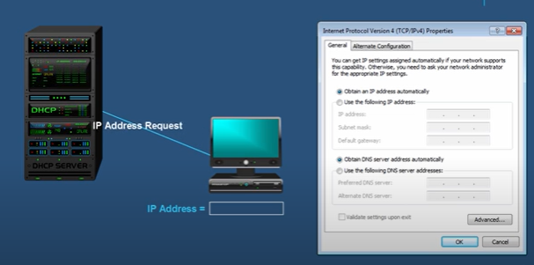
steps

Slide 50
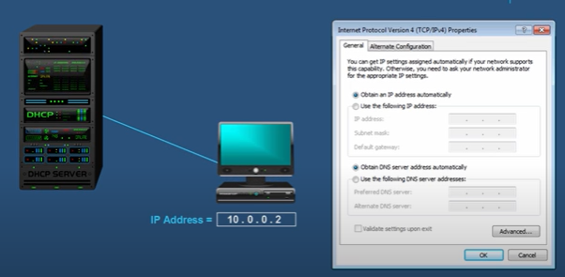
steps

Slide 51
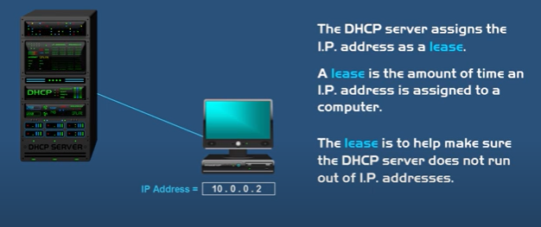
steps

Slide 52
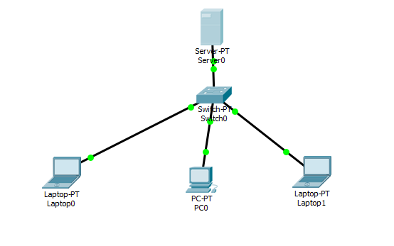
Configuration of DHCP protocol in a Network
Create single network
Required components
3 end devices (1server, 3pc)
1 switch

Slide 53
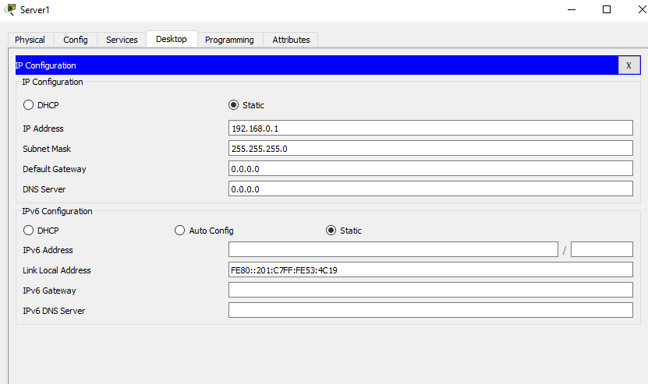
Give ip in the server

Slide 54
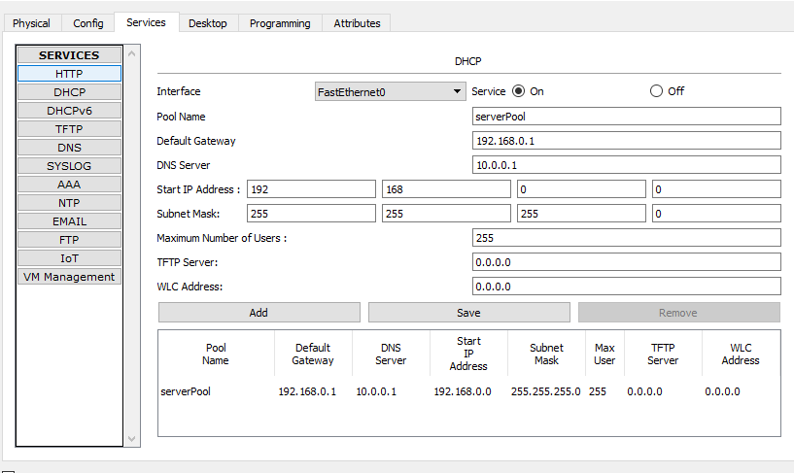
In the server>Go to Service>DHCP

Slide 55
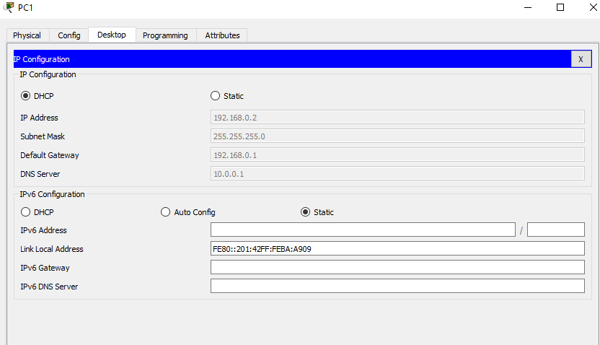
Go to PC >Go to IP > Select DHCP

Slide 56
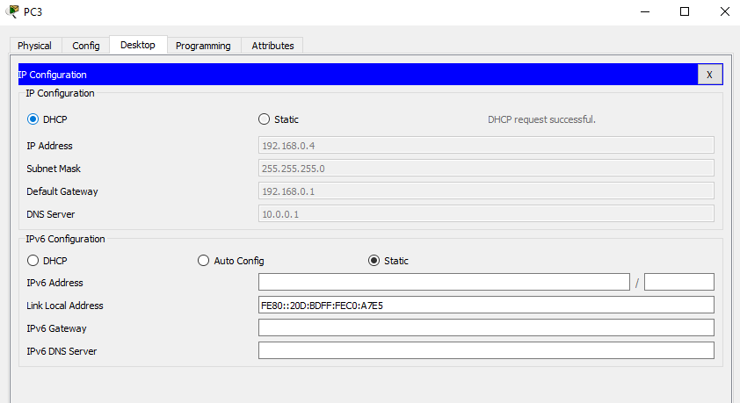
Go to PC >Go to IP > Select DHCP

Slide 57
